Slide 1

Microsoft Teams and On-Premises Mailbox - Why?
Notes:
1
1

Slide 2




Slide 3



Thomas Stensitzki
Enterprise Consultant Granikos GmbH & Co. KG MVP |MCSM | MCT Regional Lead @stensitzki thomas.stensitzki@granikos.eu
https://www.linkedin.com/in/thomasstensitzki

Slide 4
Microsoft Teams and On-Premises Mailbox
Why would you do that?

Slide 5

Microsoft Teams and On-Premises Mailbox
Why would you do that?
Compliance or regulatory requirements for keeping mailboxes in on-premises Exchange Organization
Regulatory → Financial Industry, Energy Sector, Lawyer’s Office, Critical Infrastructure, …
Contractual agreements with customers
Email Backup requirements
…
Trust issues with Microsoft as a cloud provider
→ Is cloud the right solution for your business?
…
What are your requirements for keeping mailboxes in an on-premises Exchange Organization?

Slide 6
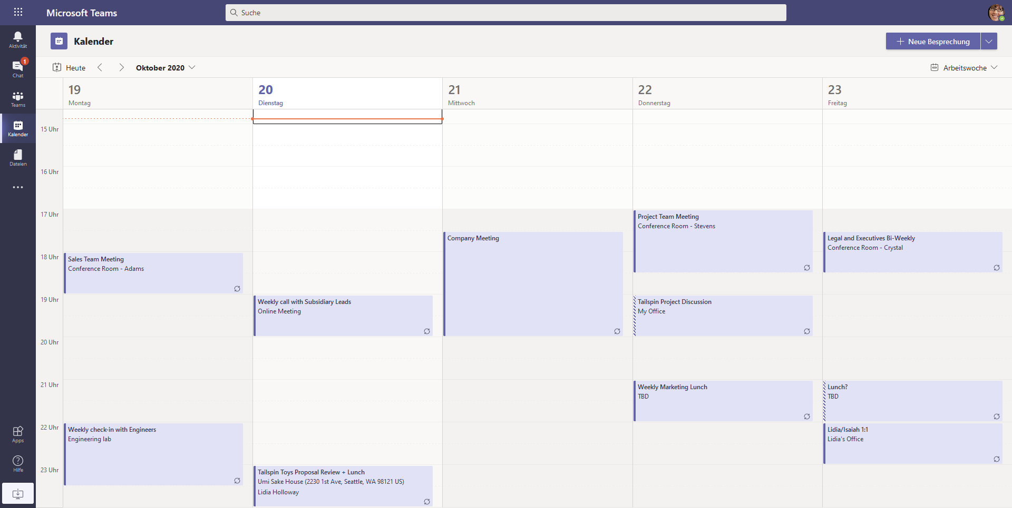
Microsoft Teams and On-Premises Mailbox
What are we talking about?
Personal calendar access
Delegate Access
Calendar-based Presence Status

Slide 7



Microsoft Teams and On-Premises Mailbox
How does calendar access work?
Teams Clients
Web
AutoDiscover
Teams Backend Services
Exchange Online
Desktop
302 HTTP Redirect
Mail User Object
iOS
App
AutoDiscover
EWS / REST
Android
App
Exchange On-Premises
Graph API

Slide 8
Microsoft Teams and On-Premises Mailbox
Exchange Server Classic Full Hybrid
Microsoft 365
Active Directory Hybrid with Azure AD Connect
Option Exchange Hybrid activated
SMTP - On-Premises and Exchange Online
Separate hostname (e.g., smtp365.varunagroup.de)
Additional public IP address
TLS certificate matching hostname
(A) Edge Transport Role in Perimeter Network
(B) Direct inbound connection
HTTPS – Inbound to Client Access Endpoints
Published via Reverse Proxy
Additional public IP address (optional)
HTTPS – Outbound to Exchange Online
On-Premises Exchange Server to Exchange Online
Optional use of outbound Proxy Server
Hybrid Configuration
Exchange Online
Azure AD
B
A
HTTPS
SMTP
Perimeter Network
Internal Network
On-Premises Exchange Organization

Slide 9

Microsoft Teams and On-Premises Mailbox
AutoDiscover flow
AutoDiscover used for determining EWS and REST API endpoints
Teams Backend Services use AutoDiscover v2 JSON only
→ Anonymous AutoDiscover request
How does it work?
Teams Backend sends AutoDiscover JSON-request to Exchange Online
Exchange Online verifies the recipient type
Mailbox → Response: https://outlook.office365.com/EWS/Exchange.asmx
Mail User → Calculation of DNS AutoDiscover endpoint based on ExternalEmailAddress attribute → e.g., autodiscover.varunagroup.de
HTTP 302 redirect response including hostname of target endpoint
Teams Backend sends AutoDiscover JSON request to on-premises Exchange organization
On-Premises Exchange Server replies with EWS or REST URL

Slide 10
Microsoft Teams and On-Premises Mailbox
Stumbling Blocks
Stumbling Block 1 – Exchange Server Version
Exchange Server 2016 CU3 or newer → required for AutoDiscover V2 support
Follow Exchange Server support life-cycle and keep your on-premises Exchange Server versions up-to-date
Stumbling Block 2 – Hybrid identities and Azure AD Connect
Exchange Online identifies on-premises mailboxes using the Mail User object information
Azure AD Connect transfers this information with the Exchange Hybrid option enabled
Stumbling Block 3 – Teams Backend Services Connectivity
Ensure proper DNS name resolution in external DNS zone(s)
No client string filtering

Slide 11
Microsoft Teams and On-Premises Mailbox
Stumbling Blocks
Stumbling Block 4 – Virtual Directory URL Settings
Ensure that external URL settings are set correctly across all Exchange Servers
Stumbling Block 5 – OAuth Authentication
Teams Backend Services must authenticate to on-premises Exchange using OAuth
Ensure that OAuth is configured correctly → Use Hybrid Configuration Wizard or follow documentation
Stumbling Block 6 – Delegate Access
Delegate access to a users' mailbox requires use of Outlook Delegate Wizard
Direct folder rights assignment does not work

Slide 12


Microsoft Teams and On-Premises Mailbox
Complex troubleshooting
Server A
Server A
Server B
IIS
EWS Proxy
IIS
EWS
TCP 443
EWS
https.sys
MSExchangeServicesAppPool (W3WP)
https.sys
MSExchangeServicesAppPool (W3WP)
Firewall
TCP 444
Reverse Proxy
EWS
Intrution Detection
Load Balancer
TLS-Proxy
any other device…
Teams Backend Services
Client Access Frontend
Mailbox

Slide 13
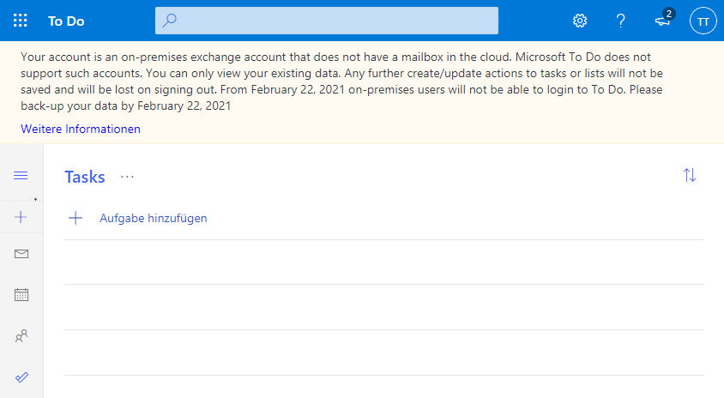
Microsoft Teams and On-Premises Mailbox
What does not work?
Access to personal contacts
Access to other calendars in your mailbox
To do and Bookings work with an Exchange Online mailbox online only

Slide 14
Questions?
Notes:
14
14

Slide 16
Thank you
Notes:
16
16

Slide 17
Ressources
Requirements to create and view meetings for mailboxes hosted on-premises
How do you configure OAuth authentication between your on-premises Exchange and Exchange Online organizations?
Use log files to monitor and troubleshoot Microsoft Teams
My user has a mailbox both on-premises and in Exchange Online. Help!
Troubleshoot Microsoft Teams and Exchange Server interaction issues

